Slide 1
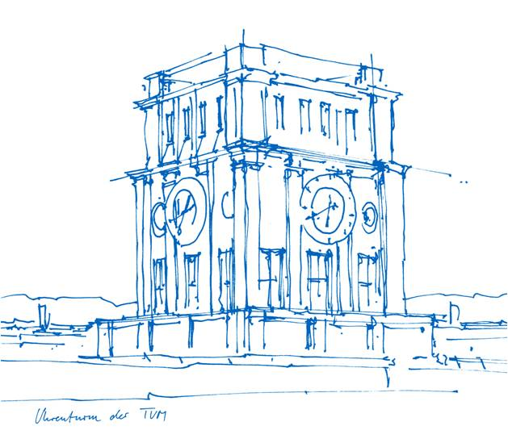
Expanding to 4D Panoptic Segmentation using Scene Flow
Niklas Bubeck, Doğaç Güzelkokar
Supervisor: Mariia Gladkova
Technische Universität München
Chair of Computer Vision and Artificial Intelligence
August 30, 2022

Slide 2
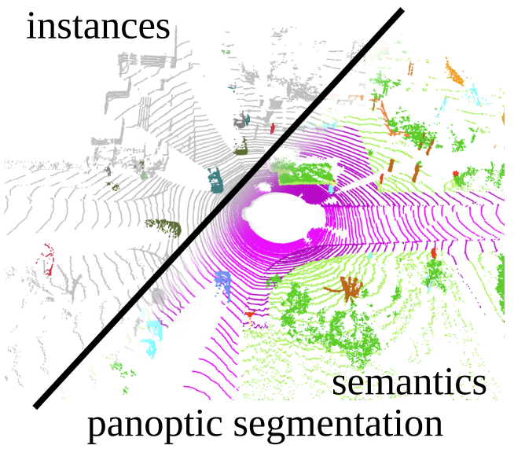
What is 4D Panoptic Segmentation?
Detect instances as well as semantics
4D refers to tracking instances over time
Mehmet Aygün, Aljoša Ošep et al., 4D Panoptic LiDAR Segmentation, 2021

Slide 3
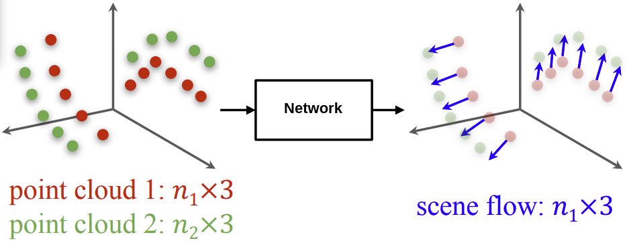
What is Scene Flow?
Find the motion for each point
Unordered points
Different number of points
3D case of optical flow
Liu, Xingyu, et al. "Flownet3d: Learning scene flow in 3d point clouds." 2019.

Slide 4
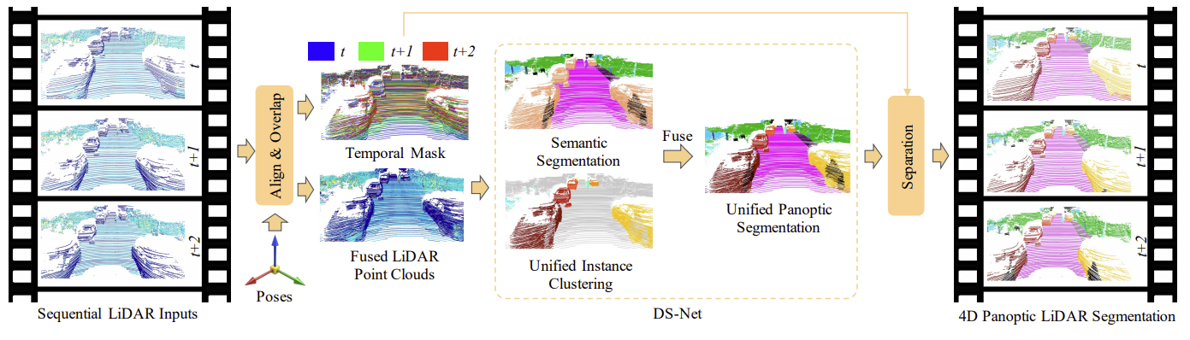
Related Work: Dynamic-Shifting Net
Apply rigid transformation
Solve 4D by aligning, predicting on aligned scans then separation
Why not compensate for object motion?
Fangzhou et al. , LiDAR-based 4D Panoptic Segmentation via Dynamic Shifting Network , 2022
Notes:
Do not spend more than 1 minute for this and 2 consecutive slides.

Slide 5
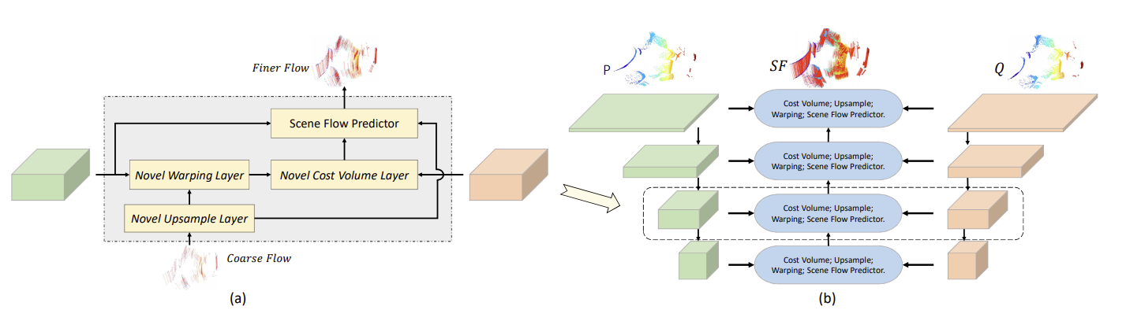
Related Work: PointPWC
Flow on different resolutions
Captures details
Introduces valuable loss functions
Why not train on semanticKitti dataset?
Wenxuan Wu et al., PointPWC-Net: Cost Volume on Point Clouds for (Self-)Supervised Scene Flow Estimation, 2020
Notes:
Do not spend more than 1 minute for this and 2 consecutive slides.

Slide 6
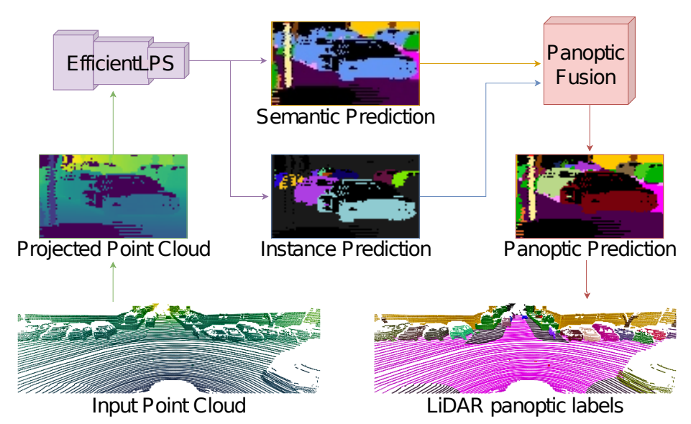
Related Work: EfficientLPS
Panoptic segmentation on image representation
Why not use on aligned scans?
Kshitij Sirohi et al., EfficientLPS: Efficient LiDAR Panoptic Segmentation, 2021
Notes:
Do not spend more than 1 minute for this and 2 consecutive slides.

Slide 7
Our Contributions
Overall concept that works with every scene flow and panoptic network
Adapted scene flow working on lower hardware requirements and semanticKitti
Intersection over union (IoU) instance matching to solve time dependency

Slide 8
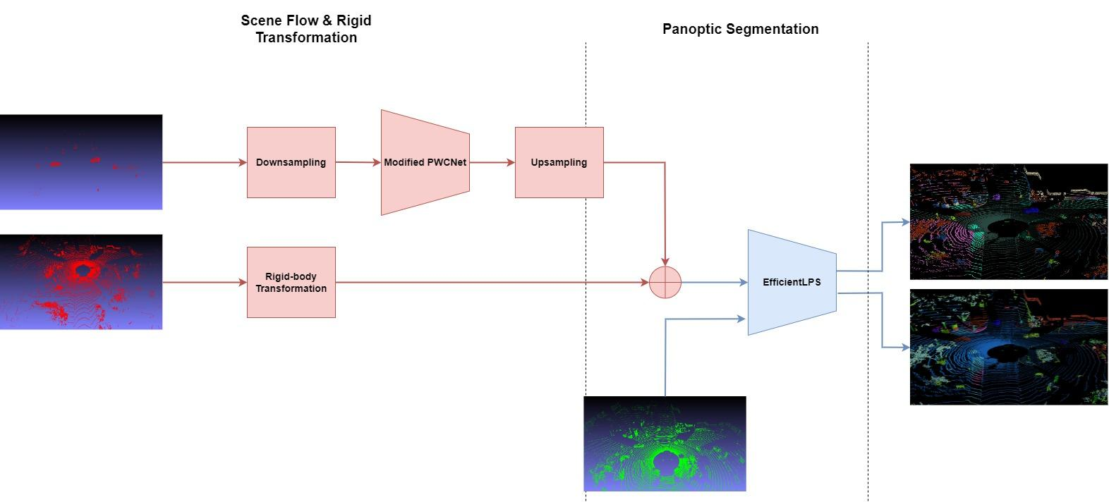
Overall Workflow

Slide 9
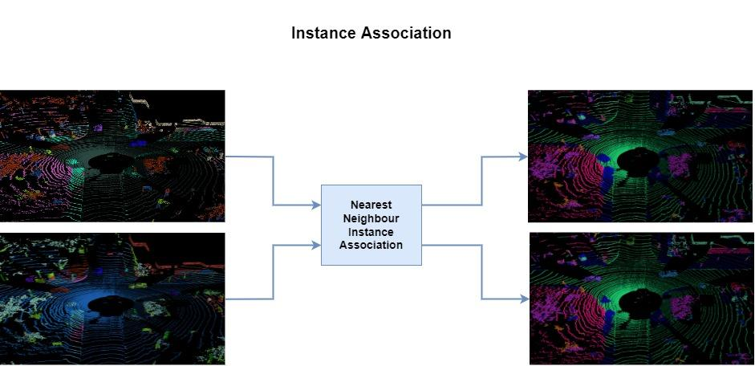
Overall Workflow

Slide 10
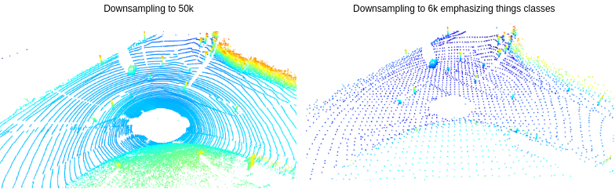
Sampling
Why:
Too much data
A lot of noise
High bias
How:
Use voxels as space representations
Emphasize different classes

Slide 11
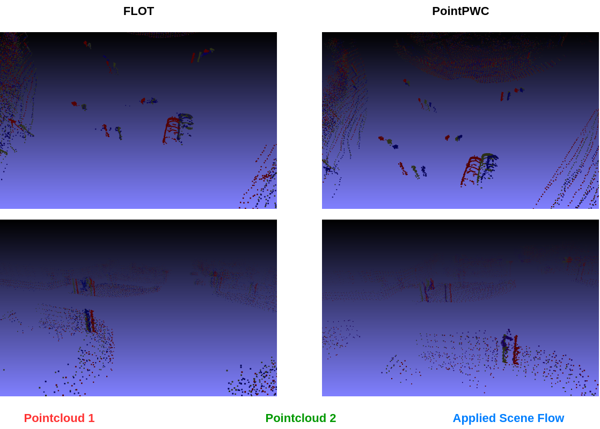
Scene Flow: Available methods

Slide 12
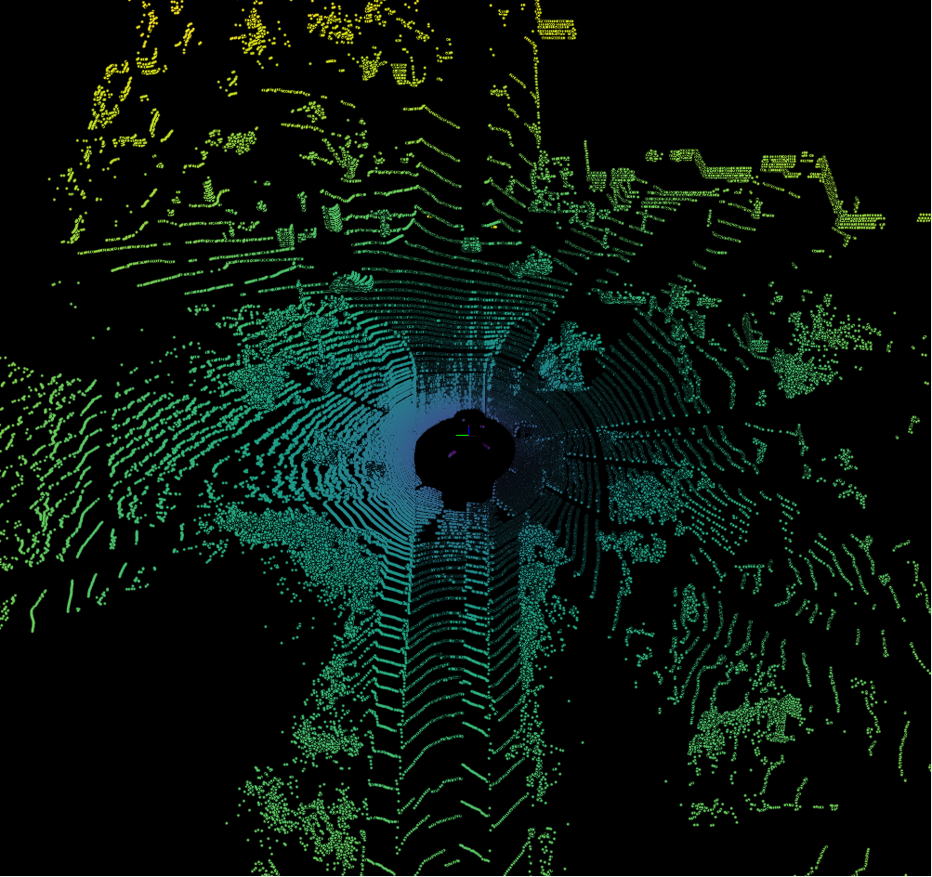
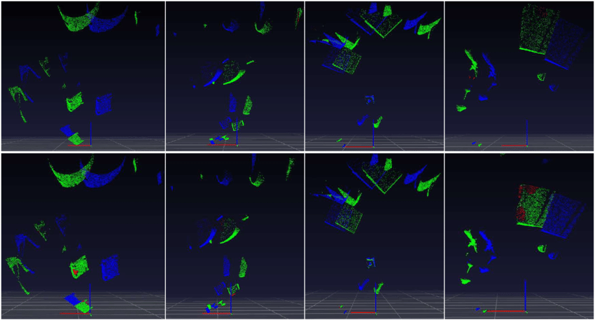
Scene Flow: Problems
RGBD vs. Pointcloud data
360deg fov → lower point density for individual objects
No color values as features
Higher number of points → exploding memory
Unordered points with varying size → No bijective mapping possible
Bidirectional reflectance disturbances cause many outliers
Mayer, Nikolaus, et al. "A large dataset to train convolutional networks for disparity, optical flow, and scene flow estimation." 2016.

Slide 13
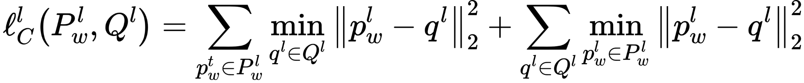
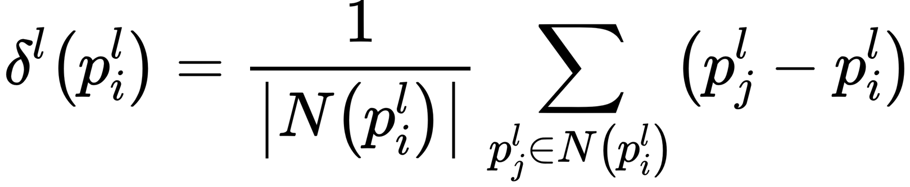
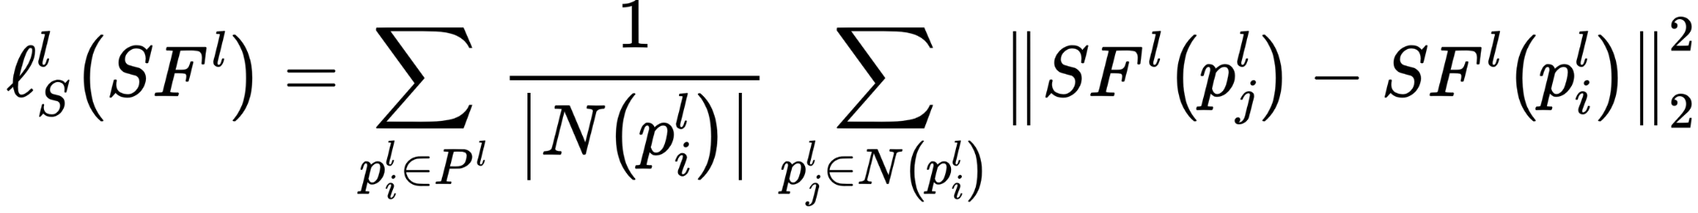
Scene Flow: Losses
Chamfer Loss:
Minimizes distance
Curvature Loss:
Local shape characteristics
Smoothness Loss:
Flow in local regions should be similar
Curvature and Smoothness act as constraint

Slide 14
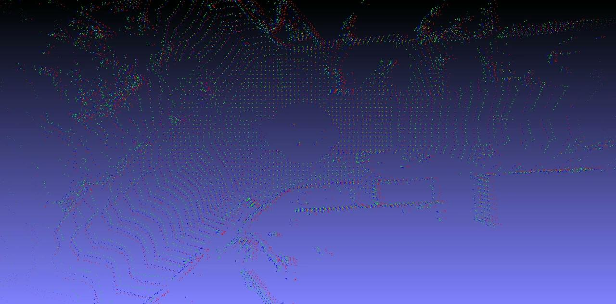
Scene Flow: Using all losses

Slide 15
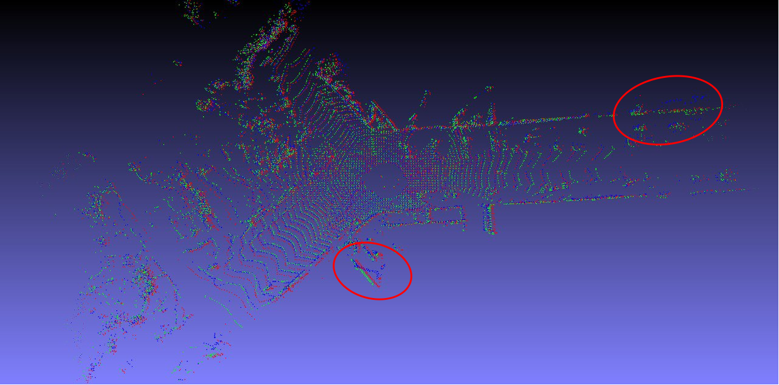
Scene Flow: Without constraints

Slide 16
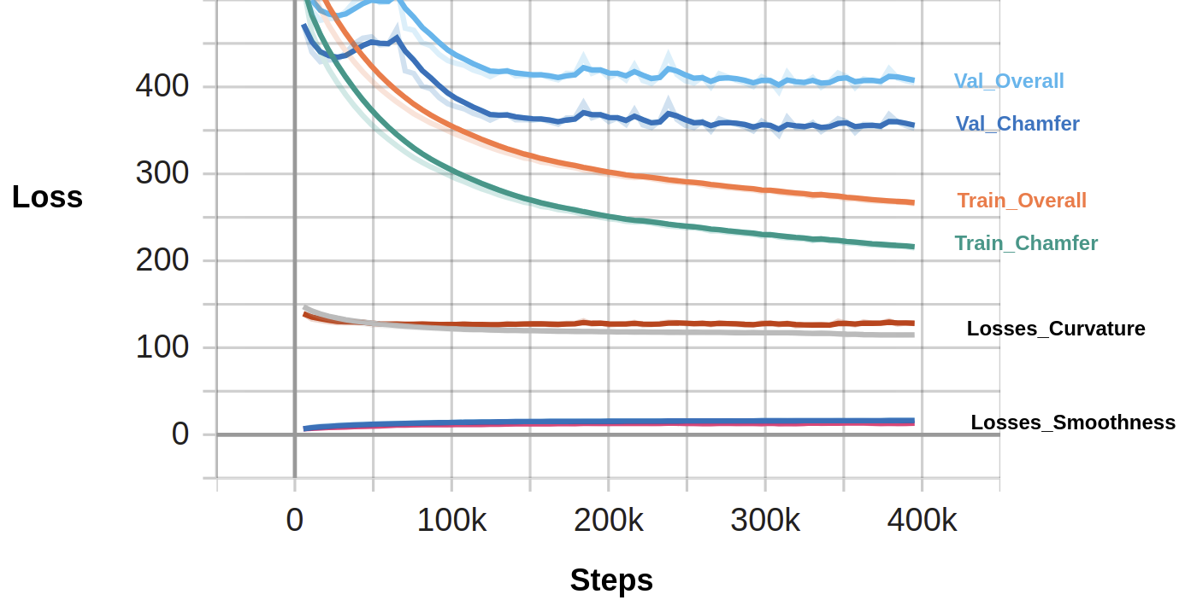
Scene Flow: Training
Emphasize things classes
Use low resolution stuff classes (better space representation)
Padding for scans with less than 8192 points
Refine with only things classes and backprojection (t → t-1)

Slide 17
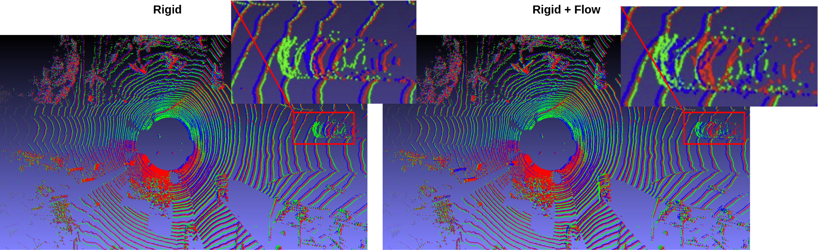
Evaluation: Scene Flow

Slide 18
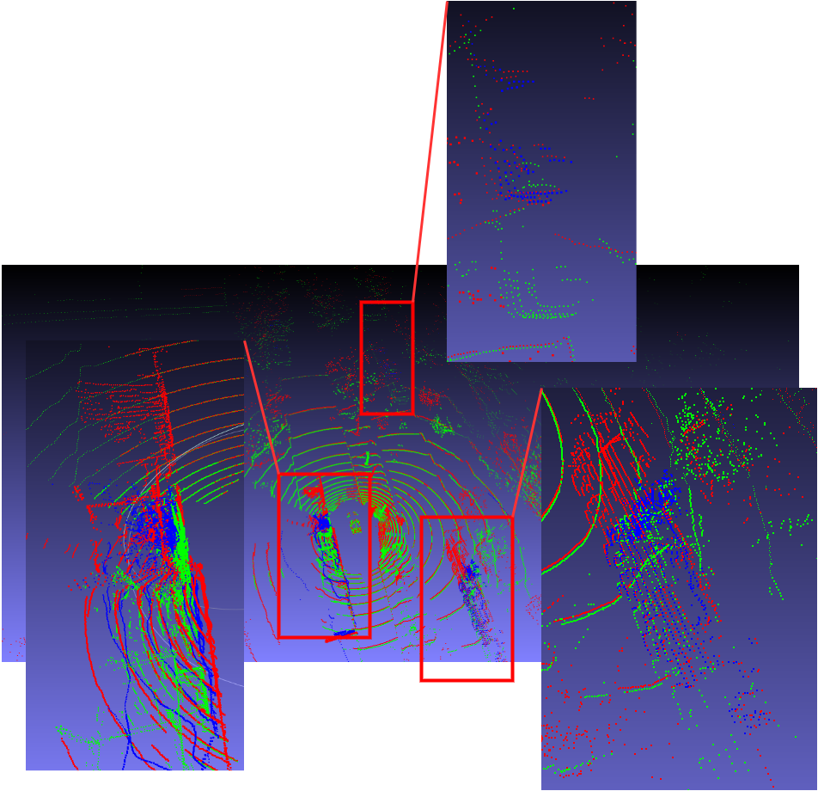
Evaluation: Scene Flow

Slide 19
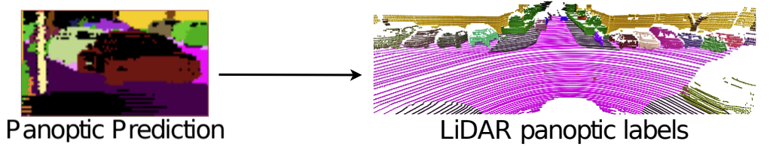
Efficient LPS: Inference
Inference on aligned point cloud did NOT work
Corrupted labels for the second point cloud of the stack
Instead: Make inference on all single scans

Slide 20
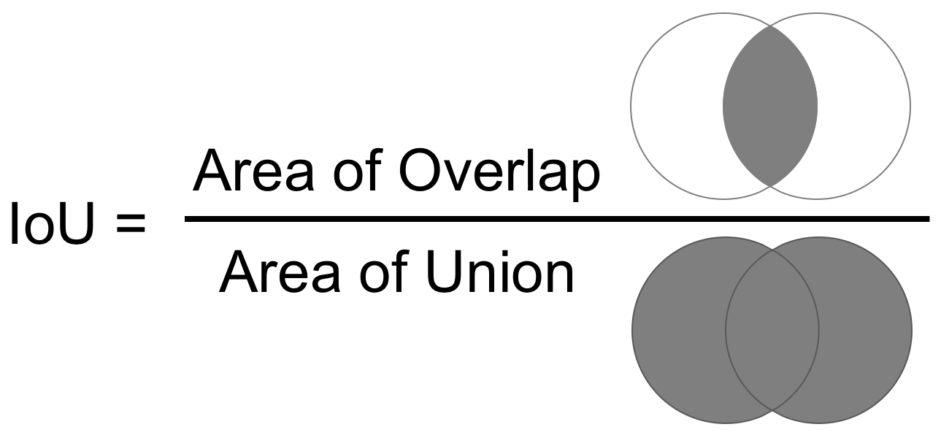
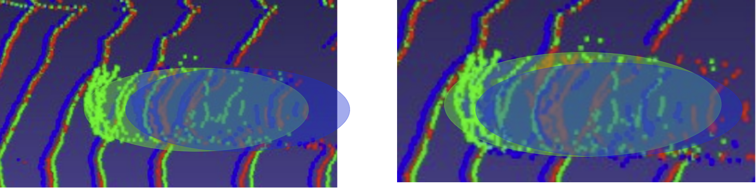
IoU-Matching
Use masks for Instance ID’s
Find nearest neighbor (NN) for each point
Assign major NN instance ID

Slide 21
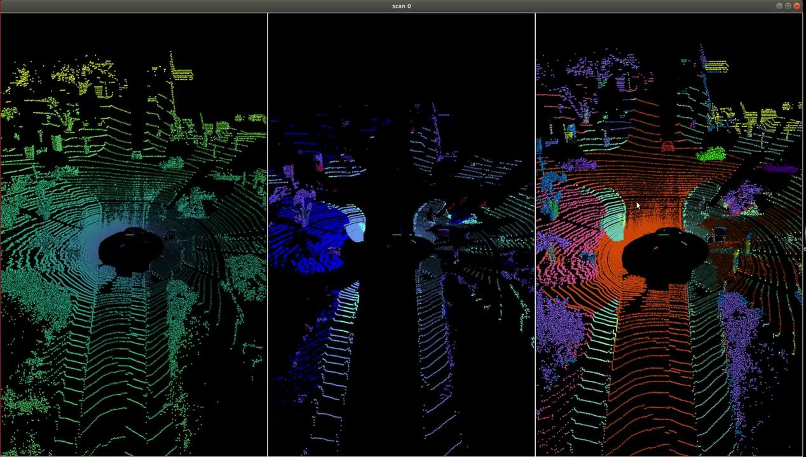
Evaluation: Panoptic Segmentation

Slide 22
Bottlenecks
Hardware requirements and dependencies
Sampling strategy introduces high variance
No Fine-tuning/ H-param Optimization of the Scene Flow
Robustness of instance mapping

Slide 23
Future Work
Run a semantic/panoptic segmentation network to obtain labels for test case, do adaptive sampling based on the outputs and apply our workflow to the test sequences.
Use better & more GPUs
Train our own or retrain existing best panoptic segmentation models for running on temporally unified scans

